Slide 1
Phonics Workshop

Slide 2
In school, we use Letters and Sounds supported by Phonics Play and other interactive resources. Letters and Sounds is split into six phases.

Slide 3
Terminology
Phoneme - The smallest unit of sound. There are approximately 44 phonemes in English (it depends on different accents). Phonemes can be put together to make words.
Grapheme - A way of writing down a phoneme. Graphemes can be made up from 1 letter e.g. p, 2 letters e.g. sh, 3 letters e.g. tch or 4 letters e.g ough.
GPC - This is short for Grapheme Phoneme Correspondence. Knowing a GPC means being able to match a phoneme to a grapheme and vice versa.
Digraph - A grapheme containing two letters that makes just one sound (phoneme). sh
Trigraph - A grapheme containing three letters that makes just one sound (phoneme). igh
CVC- It refers to words with a consonant phoneme, a vowel phoneme and then a consonant phoneme - it is not referring to letters. Therefore hot, bed, boat and ship are all CVC words but cow and toy are not.

Slide 4
Terminology
Oral Blending - This involves hearing phonemes and being able to merge them together to make a word. Children need to develop this skill before they will be able to blend written words. Robot voice
Blending- This involves looking at a written word, looking at each grapheme and using knowledge of GPCs to work out which phoneme each grapheme represents and then merging these phonemes together to make a word. This is the basis of reading. D-o-g
Oral Segmenting - This is the act hearing a whole word and then splitting it up into the phonemes that make it. Children need to develop this skill before they will be able to segment words to spell them. Sounding out...C-a-t
Segmenting - This involves hearing a word, splitting it up into the phonemes that make it, using knowledge of GPCs to work out which graphemes represent those phonemes and then writing those graphemes down in the right order. This is the basis of spelling.

Slide 5
Phase 1
Phase 1 develops children's ability to listen to, make, explore and talk about sounds. This phase is split into 7 aspects that are explored and developed through games.
The 7 aspect:
A1 – Environmental
A2 – Instrumental sounds
A3 – Body Percussion
A4 – Rhythm and rhyme
A5 – Alliteration
A6 – Voice sounds
A7 – Oral blending and segmenting.

Slide 6
Phase 2
During this phase, individual phonemes are introduced. Actions are used to help children learn them.
Set 1: s, a, t, p
Set 2: i, n, m, d
Set 3: g, o, c, k
Set 4: ck, e, u, r
Set 5: h, b, f, ff, l, ll, ss

Slide 7
Tricky Words
Tricky words are those words which cannot be sounded out correctly using the sounds. The only way these words can be read and spelt correctly is by learning them and having plenty of practise.
Phase 2 tricky Words:
I
go
no
to
the
into

Slide 8
Phase 3
Set 6: j, v, w, x
Set 7: y, z, zz, qu
Consonant digraphs: ch, sh, th, ng
Vowel digraphs: ai, ee, igh, oa, oo, ar, or, ur, ow, oi, ear, air, ure, er

Slide 9
Tricky Words
Phase 3 tricky Words:
you
they
all
are
my
her
he
she
we
me
be
was

Slide 10
Phase 4
This phase consolidates everything the children have learnt in the previous phases. The main challenge in this phase is to help children to blend and segment words with adjacent consonants e.g. truck, help. These adjacent consonant phonemes can both be heard when you say the word which makes them different from a digraph where there are two letters that make just one sound.

Slide 11
Phase 5
Children will be taught new graphemes and alternative pronunciations for these graphemes. ai/ay, igh/ie
Vowel digraphs: wh, ph, ay, ou, ie, ea, oy, ir, ue, aw, ew, oe, au
Split digraphs: a_e, e_e, i_e, o_e, u_e

Slide 12
Phase 6
The focus is on learning spelling rules for suffixes.
-s -es -ing -ed
-er -est -y -en
-ful -ly -ment -ness

Slide 13
Segmenting
Breaking down words for spelling.
cat
c a t

Slide 14
Segmenting
Queen
qu ee n

Slide 15
Blending
Building words from phonemes to read.
c a t
cat

Slide 16
Blending
Qu ee n
queen

Slide 17
What does a Phonics lesson look like?
Revisit/review | Flashcards to practice phonemes learnt so far.
Teach | Teach new phoneme ear
Practice | Buried treasure ear, zear, fear, vear, thear
Apply | Read captions: The goat had a long beard. The quack was right in his ear.

Slide 18
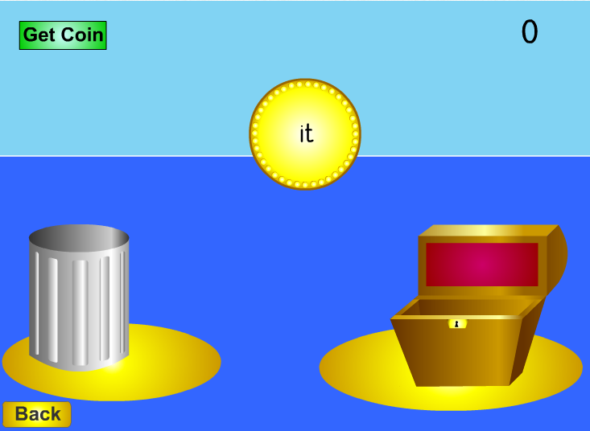
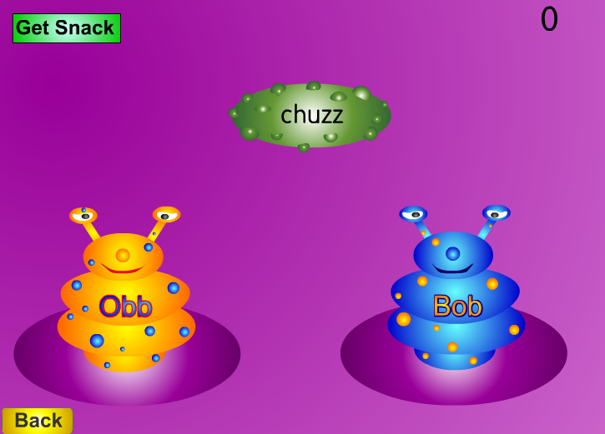
Resources
We use this resource to support the teaching and learning of phonics at school.
http://www.phonicsplay.co.uk

Slide 19
Phonics at Home
Tips for teaching your child the sounds:
It is important for a child to learn lower case or small letters rather than capital letters at first. Most early books and games use lower case letters and your child will learn these first at school. Obviously you should use a capital letter when required, such as at the beginning of the child's name, e.g.. Paul.
When you talk about letters to your child, remember to use the letter sounds rather than the alphabet names of the letters: ay bee see dee ee . The reason for this is that sounding out words is practically impossible if you use the alphabet names. e.g. cat, would sound like: see ay tee
When saying the sounds of b, d, g, j and w you will notice the 'uh' sound which follows each, for example buh, duh... You cannot say the sound without it; however, try to emphasise the main letter sound.

